Slide 1

Water abstraction presentation
Hien Nguyen

Slide 2
Outline
Motivation
Literature review
Research questions and possible predictors
Data at first glance
Regressions
Preliminary results
Concluding remarks

Slide 3
Motivation
Interested in sustainable development/environmental economics
Overexploitation of common resources
“Tragedy of the Commons”
The importance of efficient allocation of the resources
Specifically looking at water resource
The supply vs demand side
→ Focus mostly on the demand side: what determines water consumption?

Slide 4
Determining and building up proper allocation of water resource should involve both studying about the past and present water usage but also predicting the upcoming usage

Slide 5
Literature Review
Environmental Kuznets Curve
Negative relationship between economic growth and environmental quality
Issue of water over-exploitation
Quadratic form of income: water withdrawal increases until certain level of income and then it decreases
Literature shows some evidence of the relationship between economic growth and water over-exploitation (Cole, 2004; Duarte et al. 2013; Hemati et al. 2011; Katz, 2015; Stern, 2004)
Results vary across countries and time
Some papers point out that the relationship is not statistically significant
Account for country-specific socio-economic factor

Slide 6
Research questions
Investigate Kuznets Environmental Curve
Is there a relationship between water withdrawal and economic growth?
Would economic growth necessarily lead to over-withdrawal?
Would there be other influential factors?

Slide 7
Possible predictors
GDP per capita
Government Integrity index: transparency, free from corruption
Property rights index: individuals’ ability to accumulate property right, secured by laws and enforced by government
Trade freedom index: a composite measure of the absence of tariff and non-tariff barriers that affect imports and exports
Population
Industrial intensity index:
Crop production index: agricultural production for each year relative to the base period 2004-2006, which includes all crops except fodder crops
Wastewater treatment: sewage treatment connection rates, i.e. the percentage of the population connected to a wastewater treatment plant
Urbanization: urban population as % of total population
Hydroelectric production (% of total electric production)

Slide 8
Datasets
Water abstraction data from OECD of 22 countries
Looking at both total water abstraction data and water abstraction per capita
Total water abstraction (billion M3)
Water abstraction per capita (M3)
Data source for the RHS variables: OECD and World Bank

Slide 9
Data measurement method
Total water abstractions including withdrawals for public water supply, irrigation, industrial processes and cooling off electric power plants.
Mine water and drainage water are also included

Slide 10
Water abstraction at a glance

Slide 12
Exploratory Data analysis
Summary statistics
Heterogeneity across countries
Heterogeneity across year
Problems of missing variables → unbalanced panel
Need to work with small subset of the dataset

Slide 13
Working with smaller set of European countries

Slide 14
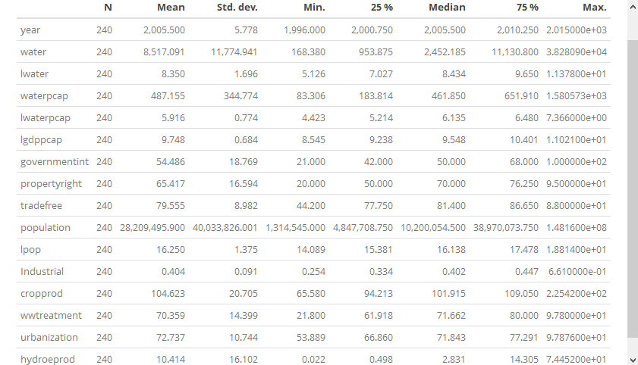

Slide 15
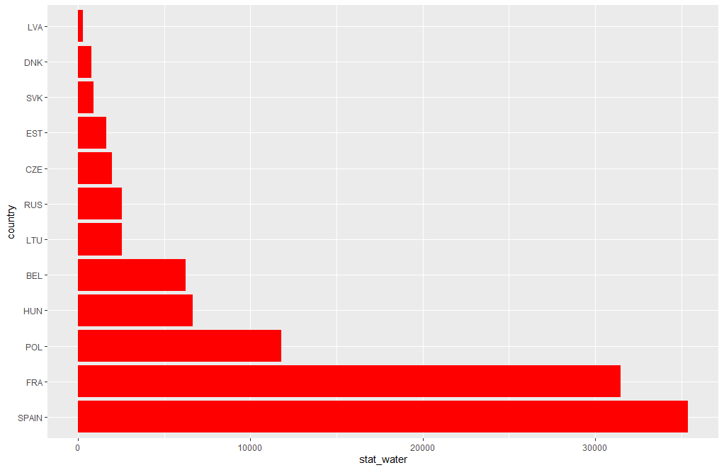

Slide 16
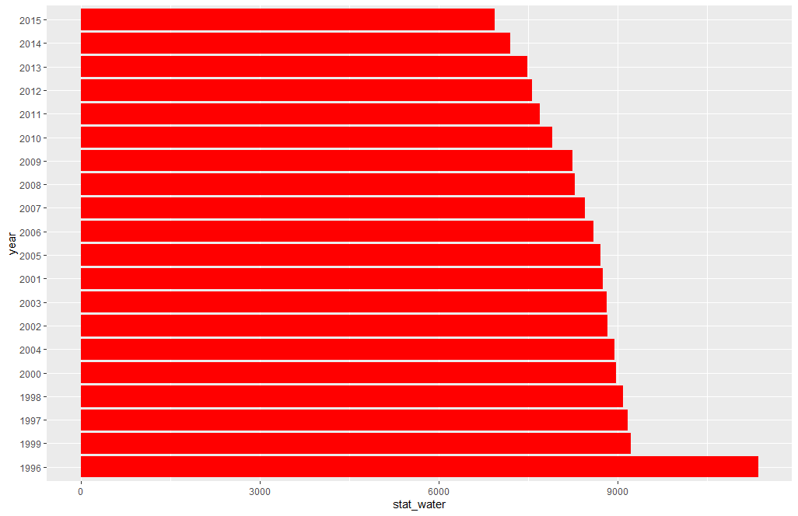

Slide 17
Possible collinearity problem
There’s problem of multicollinearity
Need to introduce interaction term?
Run different models?
After running mrobust and choosing the most important predictors, the problem of multicollinearity may be decreased

Slide 19
mrobust for most important predictor
lpop and hydroeprod are the most powerful predictors: both significant and sign stable
Some other variables are significant but are not 100% sign stable: lgdppcap, tradefree, urbanization, industrialization index, property right
Variables that both not sign stable and not significant: wwtreatment, governmentint, and crop production

Slide 20
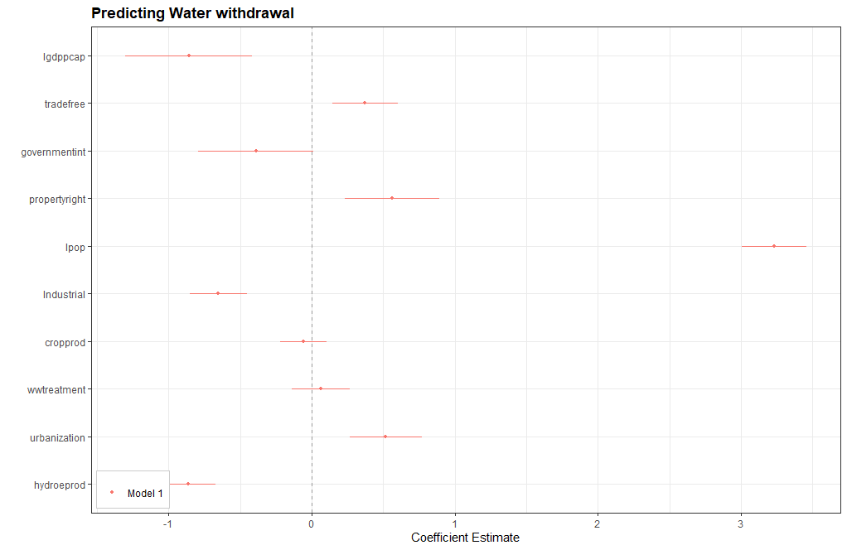

Slide 21
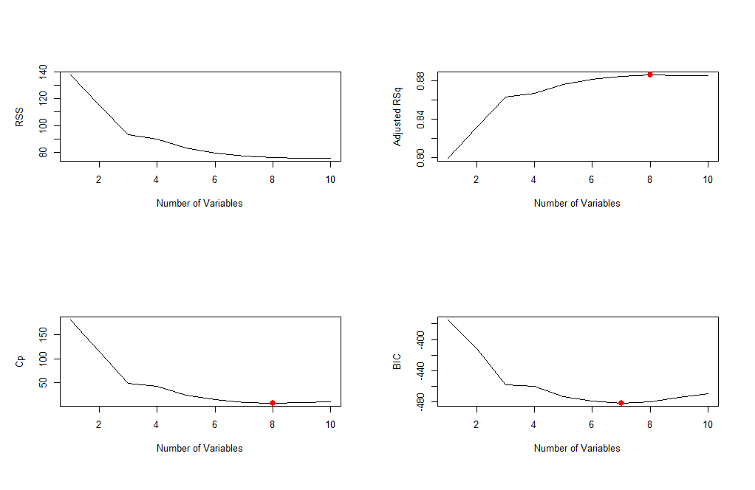

Slide 22
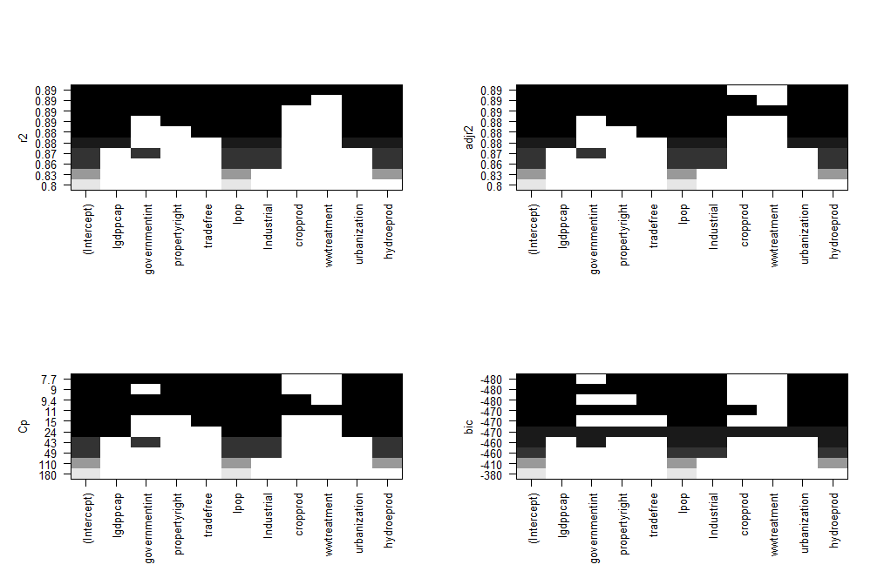

Slide 23
Linear model: preliminary results

Slide 24
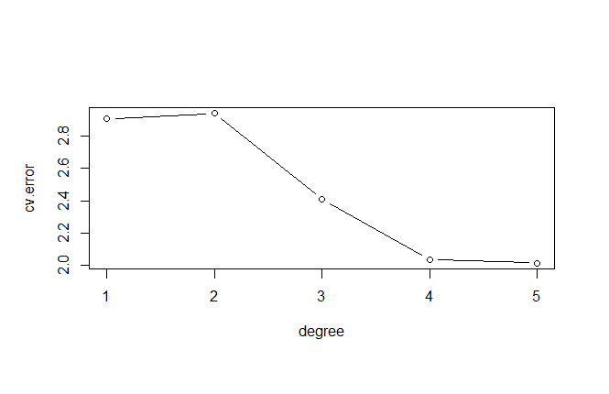
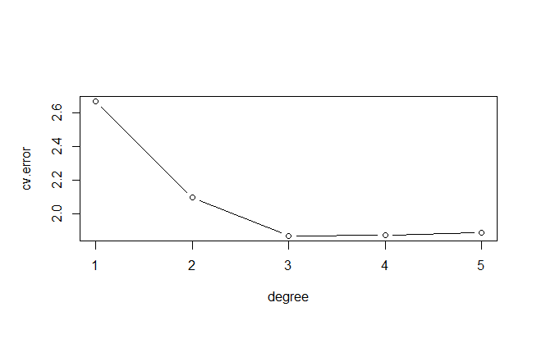
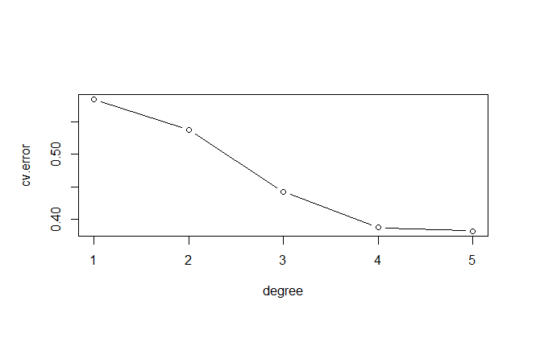
Cross validation
lgdppcap
Hydro electric production
lpop
Notes:
Higher degree more accuracy at the price of interpretability

Slide 25
Updated linear regression result

Slide 26
Concluding remarks
GDP per capita, population and hydro-electricity production play the most important role in predicting water withdrawal.
Some others also matter include: trade freedom, property right, Industrial intensity index, urbanization
The relationship between the predictors and water withdrawal is more complicated than just simple linear model (different degree for most important predictors).

Slide 27
Limitations and further research
More recent data
Data on other possible predictors: agricultural water use, industrial water use, temperature
Predict within those European countries
Extend to other countries within OECD
Using Levene test to check the for heteroskedasticity

Slide 28
References
Cole, Matthew A. 2004. “Economic growth and water use.” Applied Economics Letters.
Duarte, Rosa, Vincente Pinilla, and Ana Serrano. 2013. “Is there an environmental Kuznets curve for water use? A panel smooth transition regression approach.” Economic Modelling.
Hemati, Abdolnaser, Mohsen Mehrara, and Ali Sayehmiri. 2011. “New vision on the relationship between income and water withdrawal in industry sector.” Natural Resource.
Katz, David. 2015. “Water use and economic growth: reconsidering the Environmental Kuznets Curve relationship.” Journal of Cleaner Production.
Stern, David I. 2004. “The rise and fall of the Environmental Kuznets Curve.” World Development.

